Slide 1



Measurement of jets in Pb-Pb collisions with ALICE
Salvatore Aiola
on behalf of the ALICE Collaboration
Yale University
May 20th, 2014

Slide 2
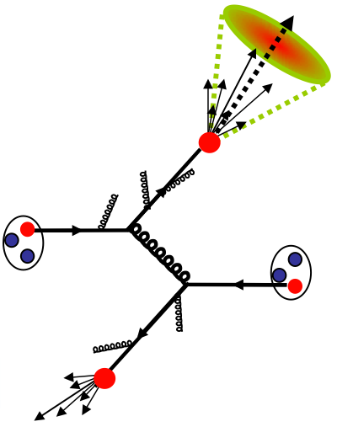
Jets in heavy-ion collisions
π±, π⁰, K±, K⁰, p, n, …
In heavy-ion collisions
scattered partons interact with the hot dense medium
Parton hard scattering
Q² >> 1 GeV²
Radiation of soft gluons and quarks
Jet quenching
suppression of jet yield
broadening of jet shape
di-jet energy imbalance
etc.
Hadronization into a colorless spray of particles
Challenge: large, fluctuating background!

Slide 3
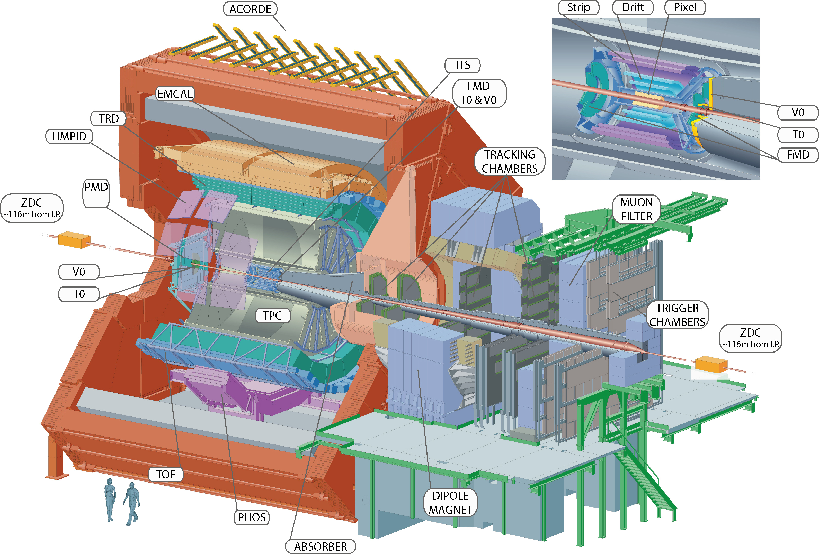
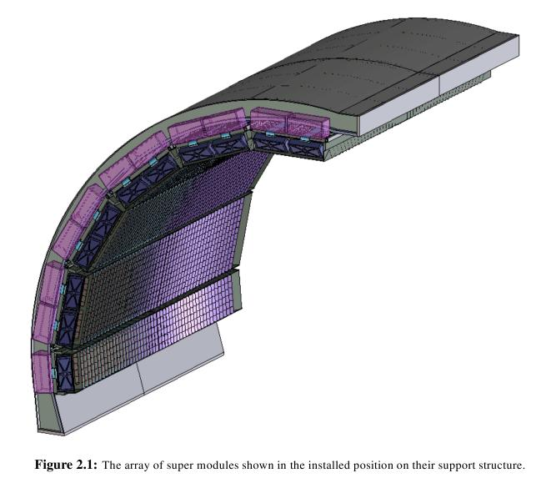
Analysis overview
Tracking: |η| < 0.9, 0° < φ < 360°
TPC: gas detector
ITS: silicon detector
Charged tracks
Charged tracks
Average background subtraction
Corrected EMCal clusters
Charged particle
correction
Start
EMCal clusters
EMCal
Pb‑scintillator
sampling calorimeter
|η| < 0.7, 80° < φ < 180°
Jet finder
anti-k_{T}
Particle level jet spectrum
Centrality in Pb-Pb collisions determined using the V0 detector: scintillator counters at forward rapidity
Unfolding
Detector level jet spectrum
f^{det} (p_{T}^{det}) = RM_{comb} (p_{T}^{det}, p_{T}^{part})× ε (p_{T}^{part}) × f^{part}(p_{T}^{part})
RM_{bkg} = Background fluctuations response matrix
RM_{comb} = RM_{bkg} × RM_{det}
RM_{det} = Detector effects response matrix

Slide 4
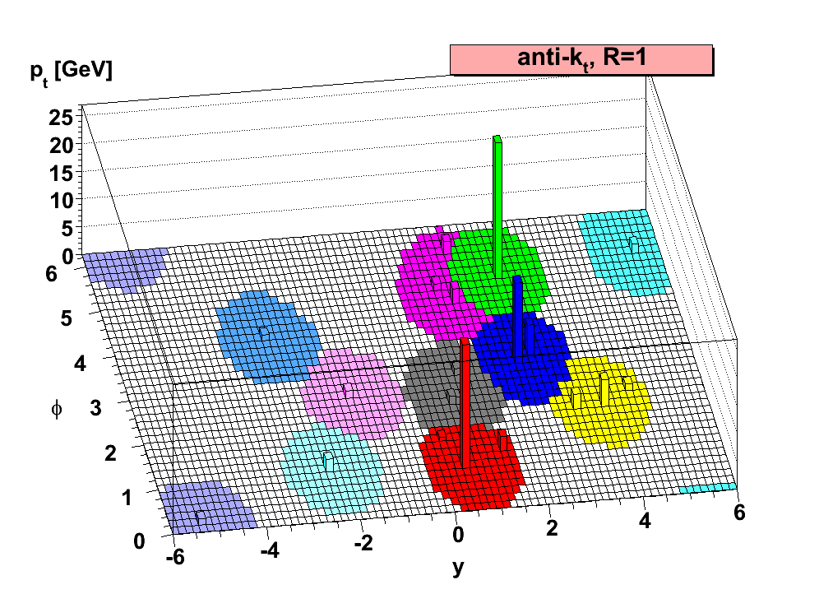
Jet reconstruction
Input to the jet finder
p_{T} recombination scheme: constituents assumed to be massless
Charged tracks with p_{T} > 150 MeV/c
EMCal clusters with E_{T} > 300 MeV after charged particle correction:
f = fraction of subtracted momentum = 100%
Fiducial cut requires jet fully contained in the EMCal acceptance
Jet finding algorithm ➔ working definition of jet which must be used consistently in phenomenological models and experiments
[2]
Sequential recombination algorithms
anti-k_{T} (stable area, signal jets)
k_{T} (background)
Infrared- and Collinear-Safe
FastJet^{[1]} implementation
^{[1]}M. Cacciari, G.P. Salam and G. Soyez
Eur.Phys.J. C72 (2012) 1896 [arXiv:1111.6097]
^{[2]}M. Cacciari, G. P. Salam and G. Soyez,
JHEP 0804 (2008) 063 [arXiv:0802.1189]

Slide 5
Average background density
Event-by-event charged background density:
Median approach reduces bias from signal jets
Scaled to account for neutral energy:
Background density in most central events:
~ 200 GeV/c per unit area
~ 25 GeV/c for an R = 0.2 jet!

Slide 6
Detector level jet spectra
Average background subtracted
0-10%
10-30%
Charged leading hadron p_{T} > 5 GeV/c (full symbols)
Suppress combinatorial background
Bias towards harder fragmentation
Comparison with inclusive jet sample (open symbols)

Slide 7
Background fluctuations
Background density fluctuates within event
Smears jet momentum
Fluctuation size characterized by δp_{T}
Asymmetric distribution
LHS: Gaussian-like dominated by soft particle production
RHS: tail due to hard particles (jets overlap!)

Slide 8
Jet momentum resolution
0-10%
10-30%
Background fluctuations
smaller for 10-30% centrality
dominate for p_{T} < 30 GeV/c
Detector effects
~ independent of centrality and p_{T}
dominate for p_{T} > 30 GeV/c

Slide 9
Jet p_{T} spectra in Pb-Pb collisions
Two centrality classes
0-10% and 10-30%
pp measurement^{[1]}
Background subtracted
Corrections applied for both detector effects and background fluctuations through unfolding
Unfolding methods
Pb-Pb: SVD, Bayesian, χ²
pp: bin-by-bin correction, Bayesian
NEW
^{[1]} The ALICE Collaboration, Physics Letters B, 722 (2013) 262 (link)

Slide 10
Nuclear modification factor in Pb-Pb collisions
Strong jet suppression observed
Dependence on centrality class
Systematic uncertainties are mainly driven by unfolding and tracking efficiency
Partially correlated between centralities
Consistent with ALICE published results on charged jet R_{CP}
The ALICE Collaboration, JHEP 1403 (2014) 013
[arXiv:1311.0633]
NEW

Slide 11
Jet p_{T} spectra in p-Pb collisions
NEW
R = 0.2
R = 0.4
Results consistent with no CNM effects on jets
Posters: M. Connors (E-06), C. Yaldo (E-39)
Similar conclusions from charged jet analysis: R. Haake (E-09)
j_{T} spectra of charged jet constituents: J. Kral (E-16)
Jets measured by ALICE in p-Pb collisions at 5.02 TeV using similar techniques
Crucial test of Cold Nuclear Matter (CNM) effects
Compared with different MC pp references

Slide 12
Comparison with theoretical models
0-10%
10-30%
Well-established models: realistic geometry, initial state conditions, hadronization
JEWEL: arXiv:1212.1599, arXiv:1311.0048
YaJEM: T. Renk, Phys. Rev. C 78 (2008) 034908, Phys. Rev. C 84 (2011) 067902
Both models fitted to single particle R_{AA}

Slide 13
Comparison with CMS
Agreement with CMS in the narrow region of overlap (only 0-10%)
It would be interesting to extend the p_{T} ranges of both analyses to have a more significant comparison
Calorimeter triggered data being used by ALICE to extend to higher p_{T}
Poster: R. Reed (E-27)

Slide 14
Event plane dependence of jets
NEW
Charged-only jets
0-5%
30-50%
Path length dependence of jet energy loss can be investigated by measuring jet v₂:
In central events (0-5%) zero v₂^{ch,jet} hypothesis can’t be excluded
Indication of v₂^{ch,jet} ≠ 0 in the 30-50% centrality class (2 sigma significance)
Poster: R. Bertens (E-02)

Slide 15
Conclusions and outlook
ALICE has measured jets in various collision systems
pp: test of pQCD at LHC energies, baseline measurement for heavy-ion collisions
p-Pb: crucial test of CNM effects, also baseline for future Pb-Pb measurements at 5 TeV
Pb-Pb: strong centrality dependent jet suppression observed relative to pp (binary scaling assumed)
CNM effects cannot account for the observed jet quenching
Strong indication of hot nuclear matter effects

Slide 16
Backup slides

Slide 17
Jet cross section in pp collisions
Jet cross sections in pp collisions have been measured by ALICE^{[1]}
Anti-k_{T}, R = 0.2 and R = 0.4
Excellent agreement with pQCD NLO with hadronization effects
Ratio R = 0.2 / R = 0.4 gives information on the jet structure
^{[1]} The ALICE Collaboration, Physics Letters B, 722 (2013) 262 (link)

Slide 18
Effect of the leading hadron bias
PYTHIA pp
5 GeV/c over inclusive
Pb-Pb collisions
10 GeV/c over 5 GeV/c
Compatible with PYTHIA pp

Slide 19
Background fluctuations - Embedding
0-10%
10-30%
Single particle embedding δp_{T} (open symbols) is compared with random cones (full symbols)

Slide 20
Detector effects
p_{T}^{part} = particle level jet p_{T}
p_{T}^{det} = detector level jet p_{T}
Jet efficiency dominated by single track efficiency of the leading hadron
Detector effects extracted from a PYTHIA+GEANT simulation
Response assumed to be the same as for pp collisions, except tracking efficiency
HIJING simulation used to determine multiplicity effects in Pb-Pb collisions

Slide 21
Unfolding
SVD regularization^{[1]} acts like a “high frequency filter” of a Fourier decomposition
Driven by an integer parameter k
^{[1]} A. Hocker and V. Kartvelishvili, Nucl. Instrum. Meth. A 372 (1996) 469 [arXiv:hep-ph/9509307]
f^{det} (p_{T}^{det}) = RM_{comb} (p_{T}^{det}, p_{T}^{part})× ε (p_{T}^{part}) × f^{part}(p_{T}^{part})
Unfolding
Mathematically ill-posed problem: regularization needed to suppress
unphysical oscillations (see k = 8)

Slide 22
List of systematic uncertainties
 | 0-10% | 10-30%
Unfolding: method, prior choice, regularization strength | 10% | 7%
Measured p_{T} range | 5% | 3%
Unfolded p_{T} range | 1% | 2%
Total unfolding | 11.2% | 7.9%
EMCal energy scale | 3% | 3%
Clusterizer | 10% | 6%
Resolution | 1% | 1%
Nonlinearity | 3% | 3%
Total EMCal | 10.9% | 7.4%
Scale factor | 2% | 2%
Tracking efficiency | 10% | 10%
Hadronic correction | 7% | 5%
Bkg. fluctuations (δp_{T}) | 5% | 2%
Flow | 1% | 2%
Total others | 13.4% | 11.7
Total | ~21% | ~16%
Most of the uncertainties are p_{T} dependent
The values shown in the table for each category correspond to the maximum uncertainty

Slide 23
Average background
Event-by-event charged background density:
Scaled to account for neutral energy:
Median approach reduces bias from signal jets

Slide 24
Charged jet R_{CP}
R = 0.2
R = 0.3
The ALICE Collaboration, JHEP 1403 (2014) 013

Slide 25
Charged particle R_{AA}
The ALICE Collaboration, Physics Letters B 720 (2013) 52
http://dx.doi.org/10.1016/j.physletb.2013.01.051.
The ALICE Collaboration, Physics Letters B 696 (2011) 30
http://dx.doi.org/10.1016/j.physletb.2010.12.020.

Slide 26
Charged jet R_{pPb}

Slide 27
Charged particle R_{pPb}
[arXiv:1405.2737]

